Slide 1



Bird Strikes
2000 - 2011
By Aniket Jamdade

Slide 2
Introduction
Transport and communication analytics are crucial for addressing environmental and safety concerns in urban areas. Bird strikes, and collisions between birds and aircraft, pose significant risks, especially during take-off, climb, approach, and landing. These incidents can cause severe damage and engine failures. The document provides visual data on bird strikes collected by the FAA from 2000 to 2011.

Slide 3
About Dataset
The dataset on bird strikes, collected by the FAA from 2000 to 2011, includes detailed records of incidents involving aircraft and wildlife collisions. It features information on the location, altitude, aircraft type, number of wildlife struck, impact on flight, and damage caused. Additionally, it provides details on wildlife species, weather conditions, warnings issued, financial costs, and injuries. This data aids in analyzing bird strike patterns and impacts to enhance aviation safety and develop effective mitigation strategies.

Slide 4
Timeline
2000
2009
2011
< 8% in Bird Strikes
Increased in bird Strikes
> 10% in Bird Strikes

Slide 5
Main KPI’s
Total $ Cost: Total Cost Caused by Bird Strikes
Total Wildlife Struck: Sum of Actual number of Wildlife Struck
Average Altitude: Planes that fly at altitude on an average when bird strikes happen.
Unique Species: Total number of unique species that struck planes.
Species Remains Collected: Total number of unique species remains collected from the engine in that incident
Species Sent to Museum: Total Number of unique species sent to Smithsonian Museum to memorialize the incident.

Slide 6
Pages
Overview: Show overall summarization of the Bird Strikes from 2000-2011
Aircraft: Detail Analysis of the Aircraft and Bird Strikes from the different phases of the flights to the type of wildlife struck to the model of the plane.
Species: Detailed analysis of different species types to understand the most probable time, condition, and weather these wildlife struck.
Wildlife Preserved: Descriptive Analysis of the species remains that can be collected and sent to the museum.

Slide 7
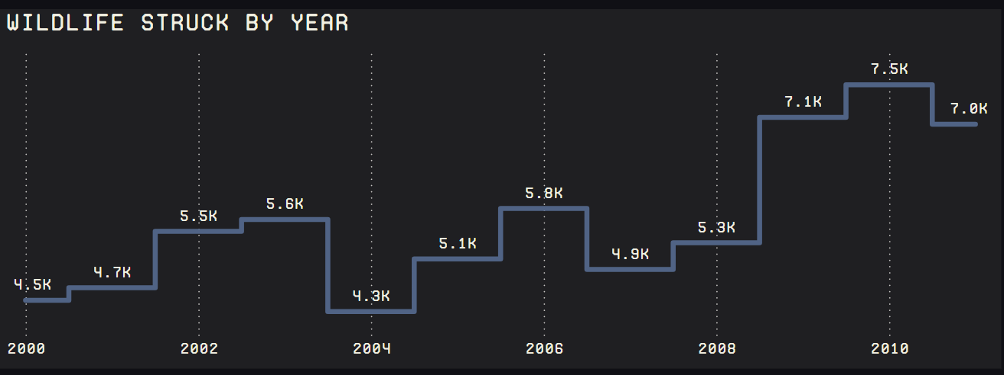
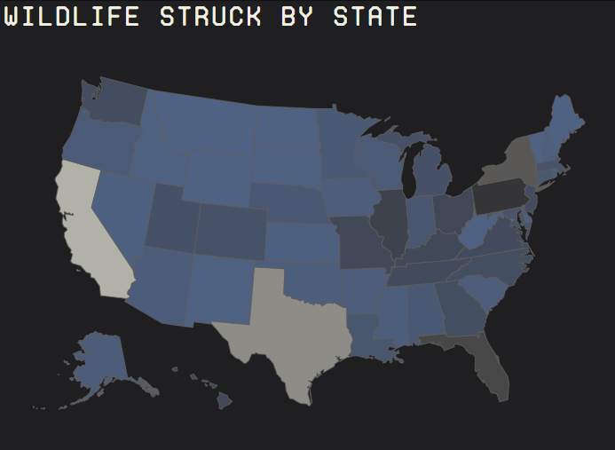
Insights-Overview
We can see that from 2009 the total bird strikes increased by a lot and New York is the state with the most wildlife struck since it’s the busiest state.

Slide 8
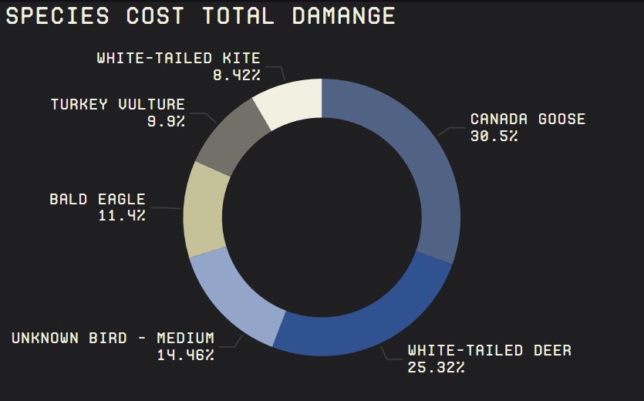
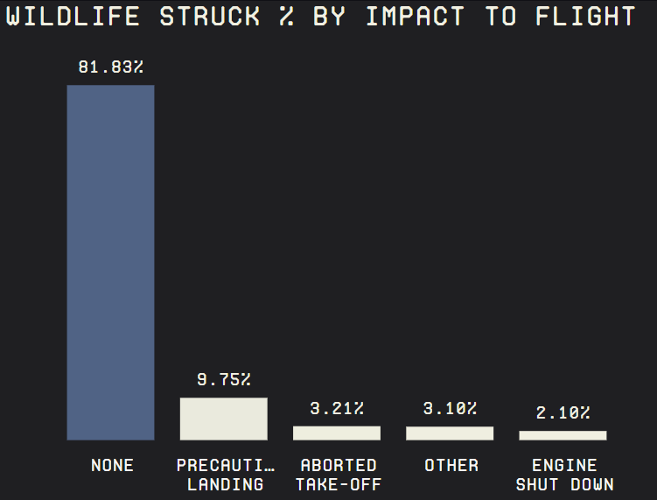
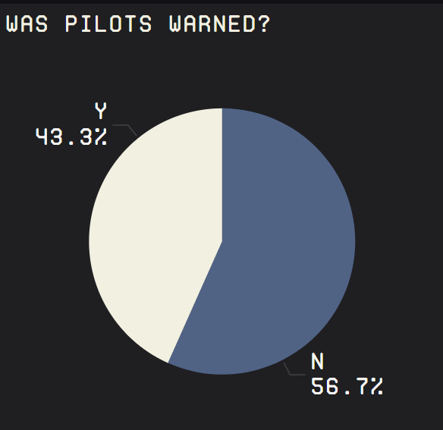
Insights-Aircraft
I was also surprised to see that White-Tailed Deer made the list of animals causing significant damage to aviation. Although the data primarily focuses on bird strikes, land animals like deer can also pose serious risks. Sometimes, deer wander into airports and get sucked into engines while planes are in taxi mode. Being larger than birds, deer can cause massive damage, increasing repair costs.
In the bar chart, the impact on flights is minimal in most cases, but some bird strikes lead to engine failures, necessitating precautionary landings.
‘Pilots warned before’ Is a 50-50 chance of predicting when wildlife will come into contact with a plane, making it a challenging issue to address.

Slide 9
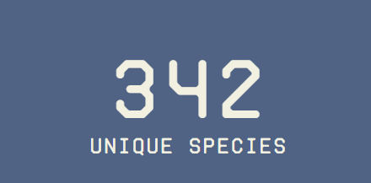
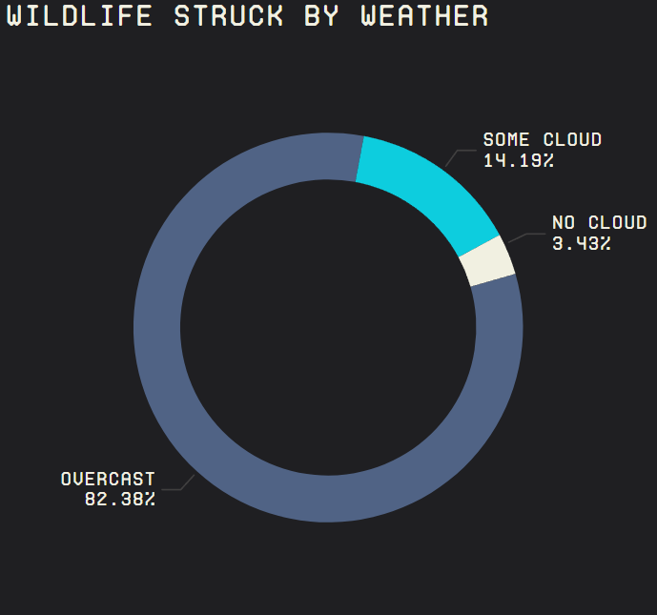
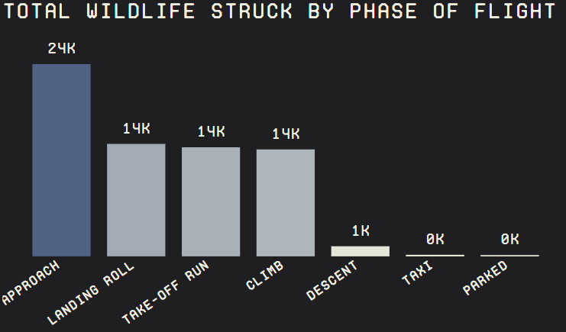
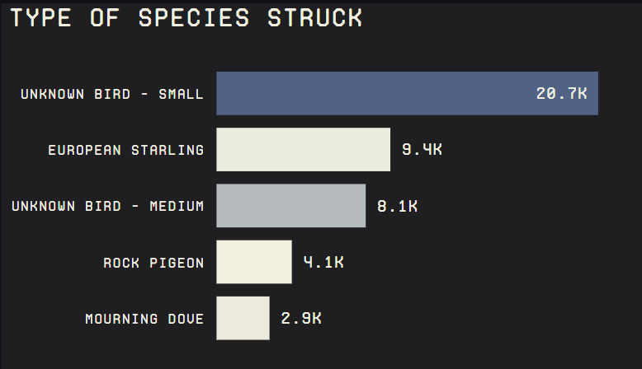
Insights-Species
There are a total of 342 unique species that struck flights.
Mostly these are unknown small birds and are not recognized when the remains are collected from the engines. European Starling is the 2nd most struck species which is commonly found in the USA.
These wildlife mostly roam around in the sky when it is overcast and struck when the plane is approaching the landing strip.

Slide 10
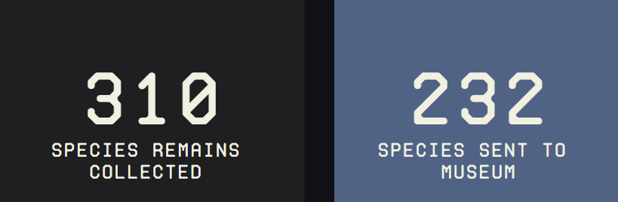
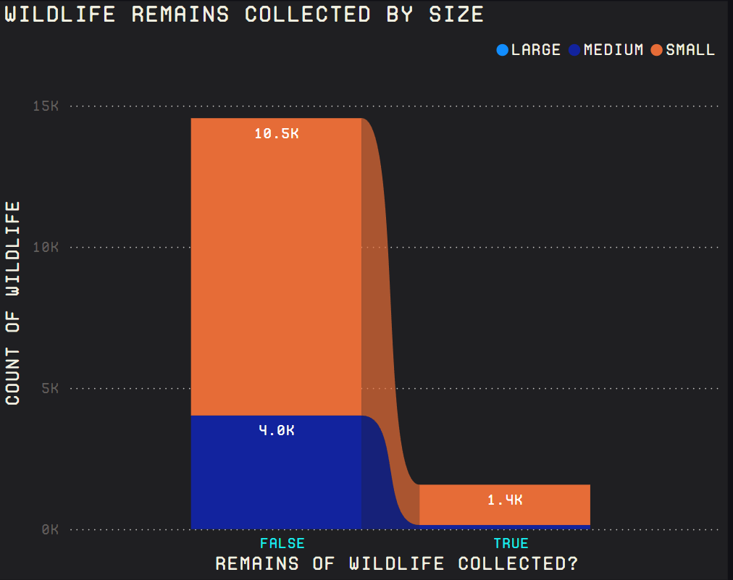
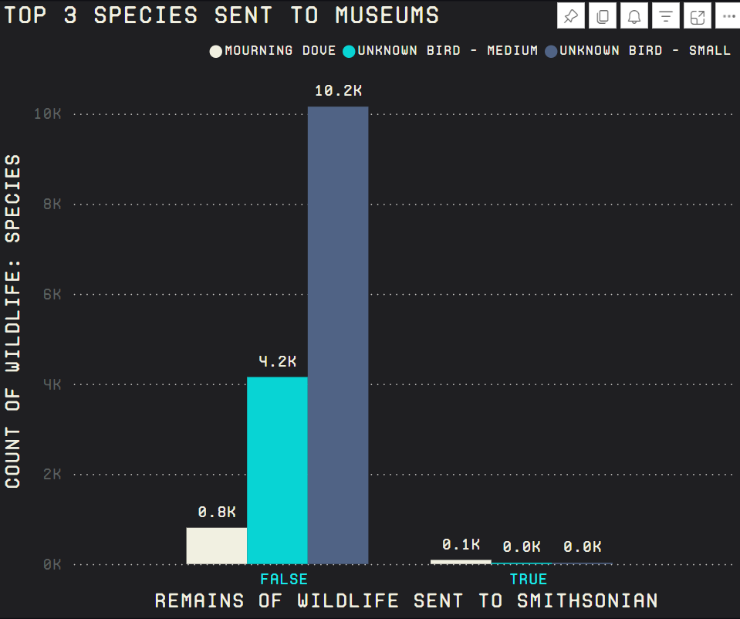
Insights-Wildlife Preserved
There are a total of 310 unique species collected but only 232 got sent to the Museum.
By the bar graph we can tell that mostly small-sized wildlife remains survives the most to be collected and sent to the Museum. All the large wildlife remains somehow can’t survive to be collected.
The Morning Dove is the favorite species of the Smithsonian Museum to be showcased in their gallery.

Slide 11
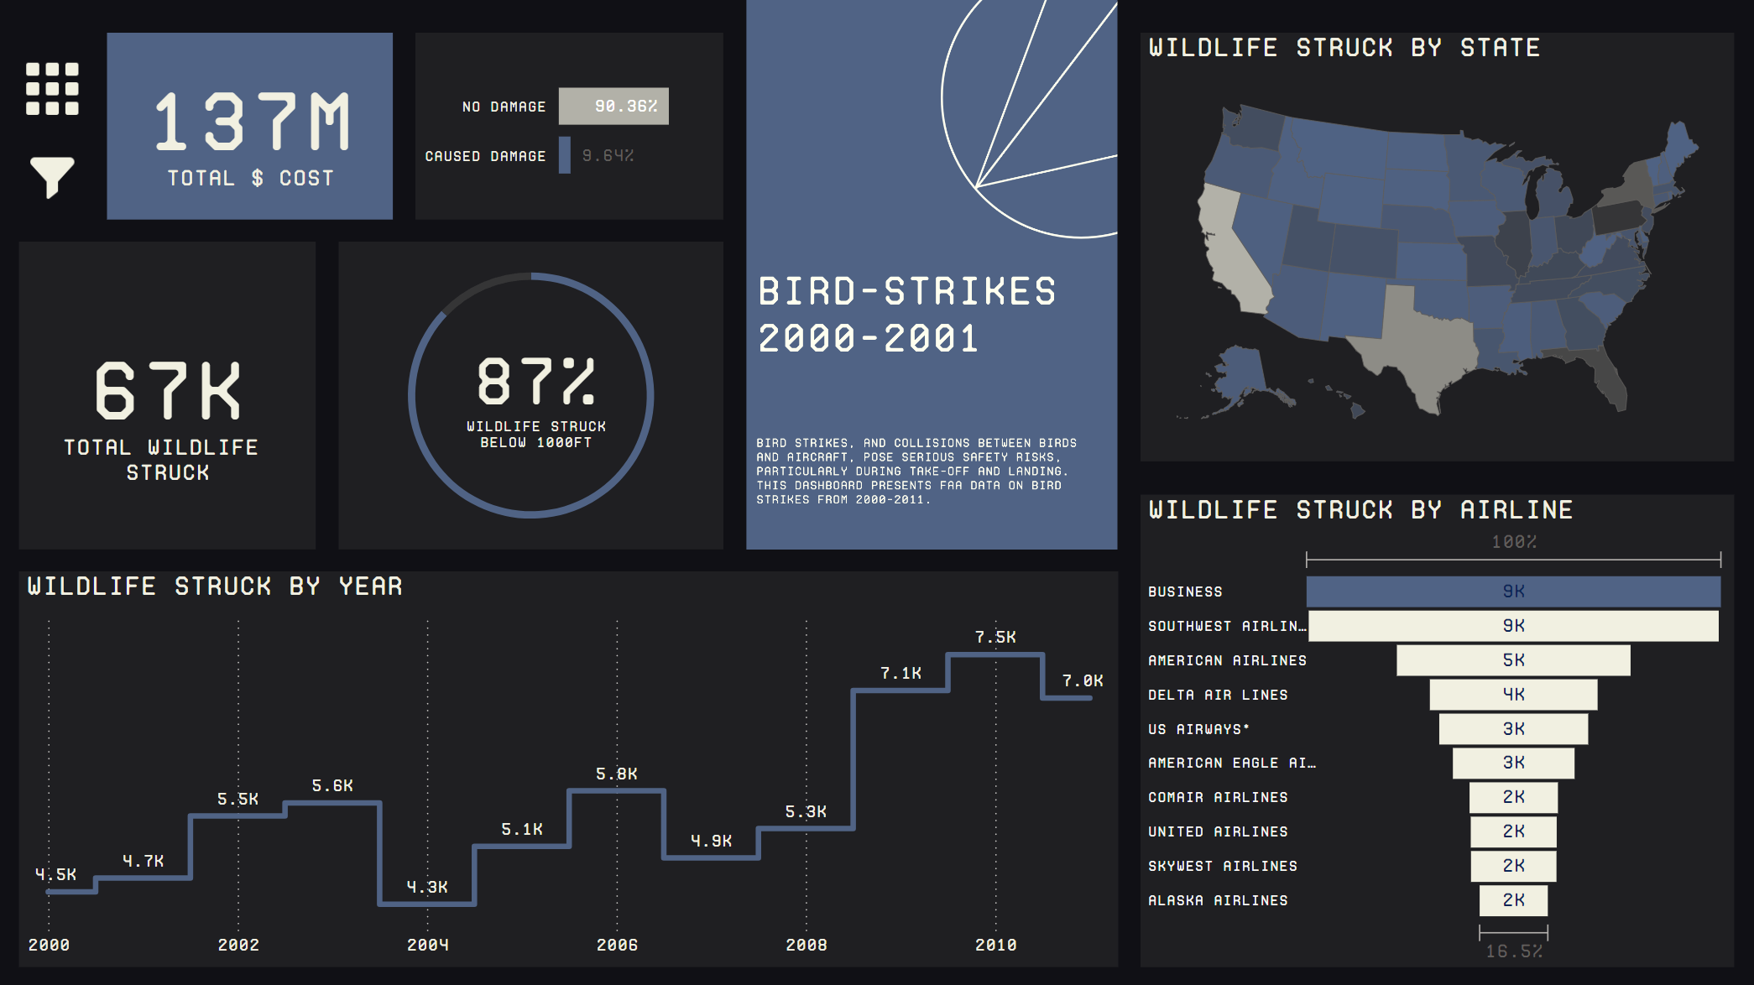
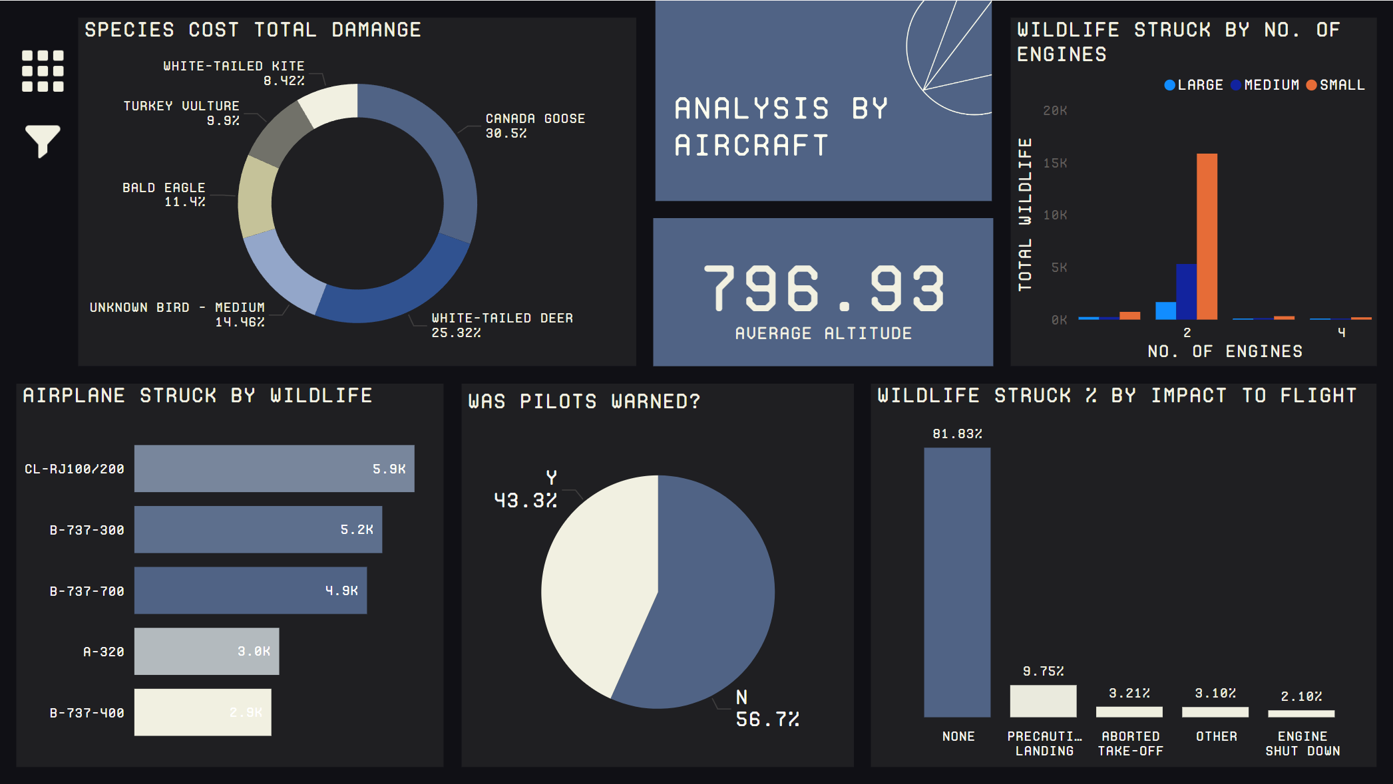
My Design
Link to Report

Slide 12
Thank you

